Slide 1


CargoChain
Reinventing International Trade
Saving Trees, Lowering Pollution, Saving Time
Via Blockchain
Shanghai Blockchain
Hackathon 2016

Slide 2
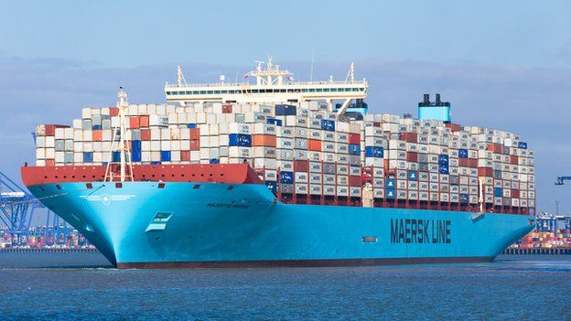
International Trade
Example- Shanghai Port Handled 32 Million Shipping Containers In 2013
60% Of Global GDP (2013)
42% Of China GDP (2013)
$18 Trillion USD Trade Volume Of Merchandise (2013)

Slide 3
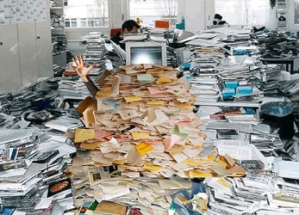
Problem
Current International Trade Practices Require Large Amount Of Duplicate Paperwork

Slide 4
Problem
Current International Trade Practices Require Large Amount Of Duplicate Paperwork
Multiple Copies Are Used To Verify Authenticity

Slide 5
Problem
Current International Trade Practices Require Large Amount Of Duplicate Paperwork
Multiple Copies Are Used To Verify Authenticity
The Bill Of Lading (BOL) Is A Good Example

Slide 6

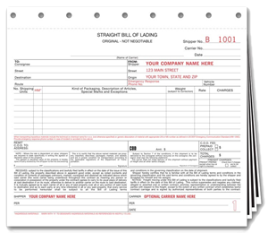
Problem—Bill Of Lading
BOLs Often Are In Triplicate Or Quadruplicate

Slide 7
Problem—Bill Of Lading
BOLs Often Are In Triplicate Or Quadruplicate
BOLs Are Required For Every Logistics Shipment For Export/Import And Domestic Shipments

Slide 8
Problem—Bill Of Lading
BOLs -- In Triplicate Or Quadruplicate
BOLs -- Required For Every Logistics Shipment For Export/Import And Domestic Shipments
BOLs -- Considered One Of The 3 Main Documents of Trade

Slide 9

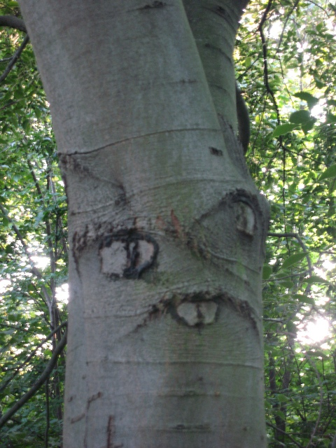
Problem—Trees
All Of The Paperwork Used For Trade Requires Lots Of Trees To Produce The Paper

Slide 10
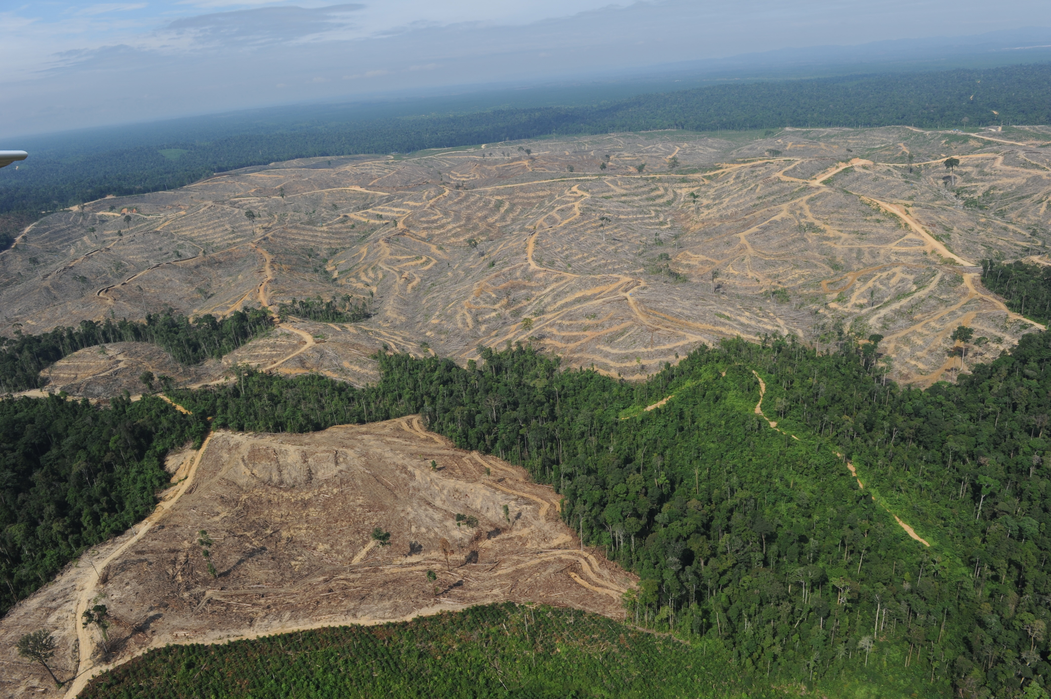
Problem—Trees
All Of The Paperwork Used For Trade Requires Lots Of Trees To Produce The Paper
This Causes Deforestation And Produces Pollution

Slide 11

Pandas ❤️ Trees

Slide 12

Pandas ❤️ Trees
Pandas Becomes Sad With No Trees

Slide 13

Pandas ❤️ Trees
Sad Pandas Become Unpredictable

Slide 14

Problem—Inefficiency
Current Standard Requires Physical Documents To Be Shipped Between Exporter And Importer
This Is To Validate Document Security (i.e. Documents Are Real)
Couriering Documents Wastes Time And Causes Further Environmental Pollution
Air Pollutants From Vehicles Used In Transportation
Current Standard Allows For Possible Loss Of Physical Documents, Thus Causing Both Parties Hassle And Delay To Reissue

Slide 15

We ❤️ Pandas and Trees We 💔 Time Waste and Pollution
We Devised A Solution To The Problems Of:
Document Authentication
Payment Upon Production Of Documents
Inefficiency/ Time Delay To Ship Physical Documents
Risk Of Loss Of Physical Documents

Slide 16
Introducing

Slide 17

Introducing

Slide 18
CargoChain
Simple Document Chain Of Custody For Trade Documents
Transmission Of Secure Documents Without The Delay Of Couriering
Reduces Fraud
Automated Payment Release For Producing Documents Required (Such as BOL)
Automated Escrow And Guarantee Of Payment
Built In Penalties For Delays
Automates Separate Smart Contract Between Shipping Companies And Importers For Penalties
Simple User Interface That Any Importer, Exporter, Shipper, Logistics Company Can Navigate And Use

Slide 19
CargoChain
DEMO

Slide 20

Improvements
“Ready are you? What know you of ready?”
Yoda

Slide 21

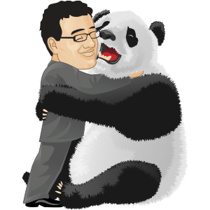
Thank You

Slide 22
Team
Coding- Dominik Schiener
Presentation- John Reyes Freeman

